Slide 1
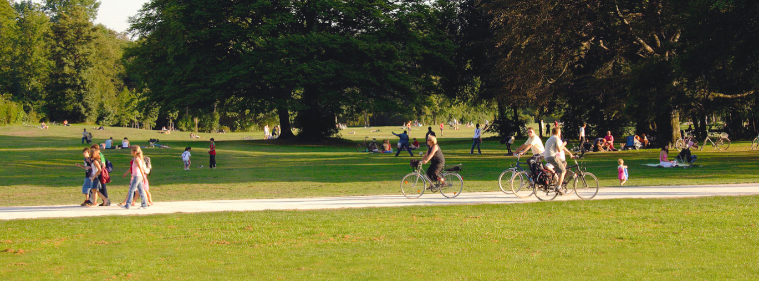


Karrot
A place to meet locally to buy and sell!
Team Members
Jingyu An
Hyunju Roh
Patrick Loutfi
COMMUNITY

Slide 2



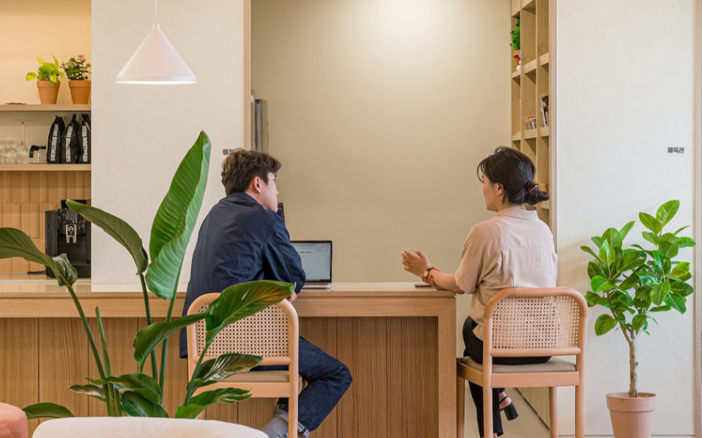
Business Concept
Features
To provide a simple way to do transactions for your local community in a safe, easy, and reliable way!
Ease of use
Facilitate easy transactions
Rating of sellers/reviews
Chatting (for specific questions)
Location (API)
Accounts for user and admin

Slide 3
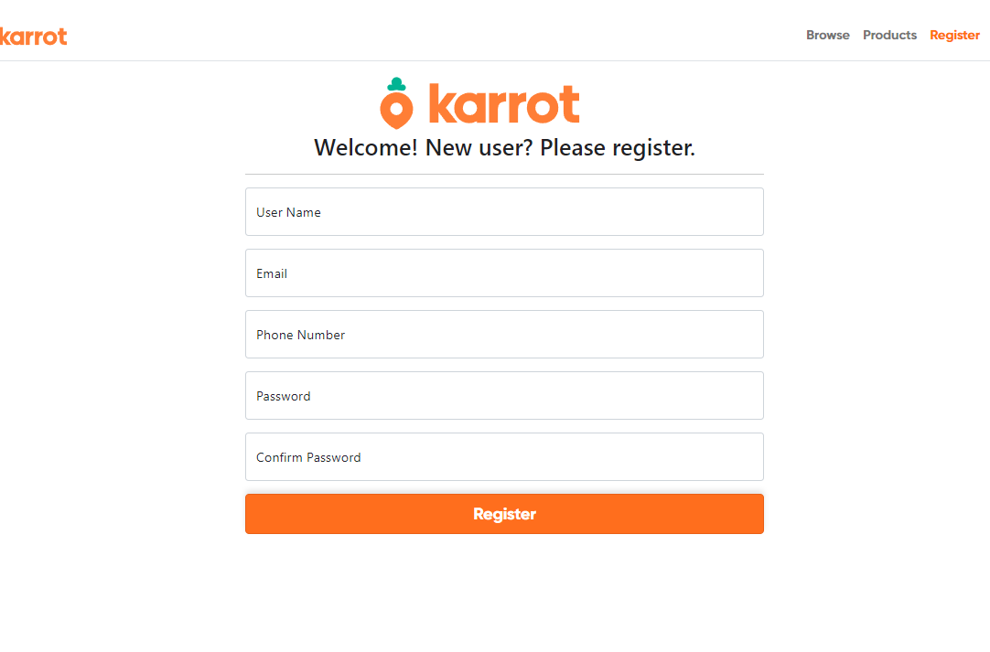
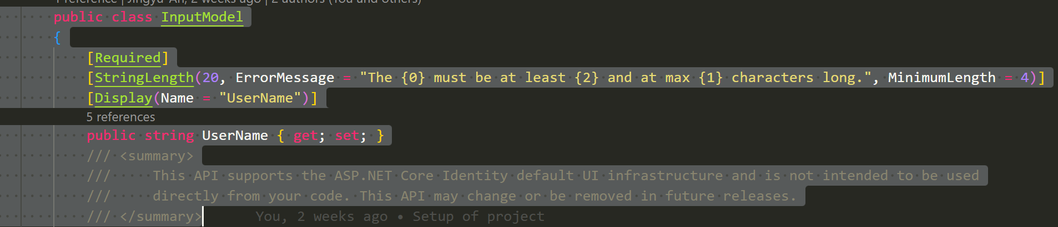
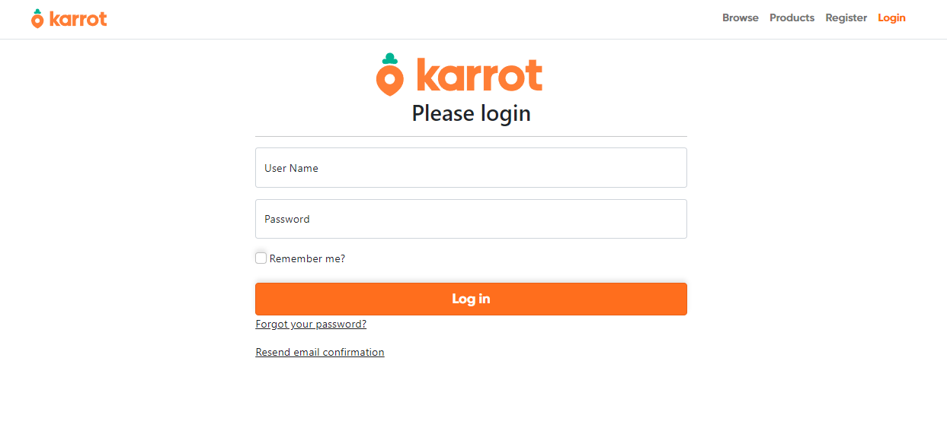
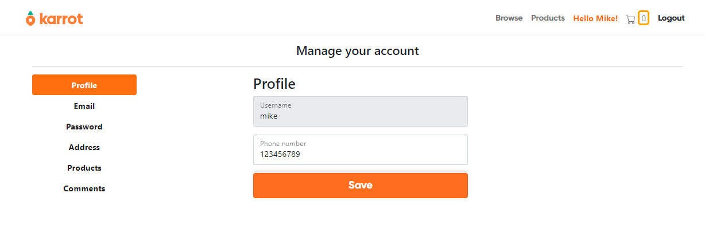
Use Scaffolding! Efficient and uniform

Slide 4
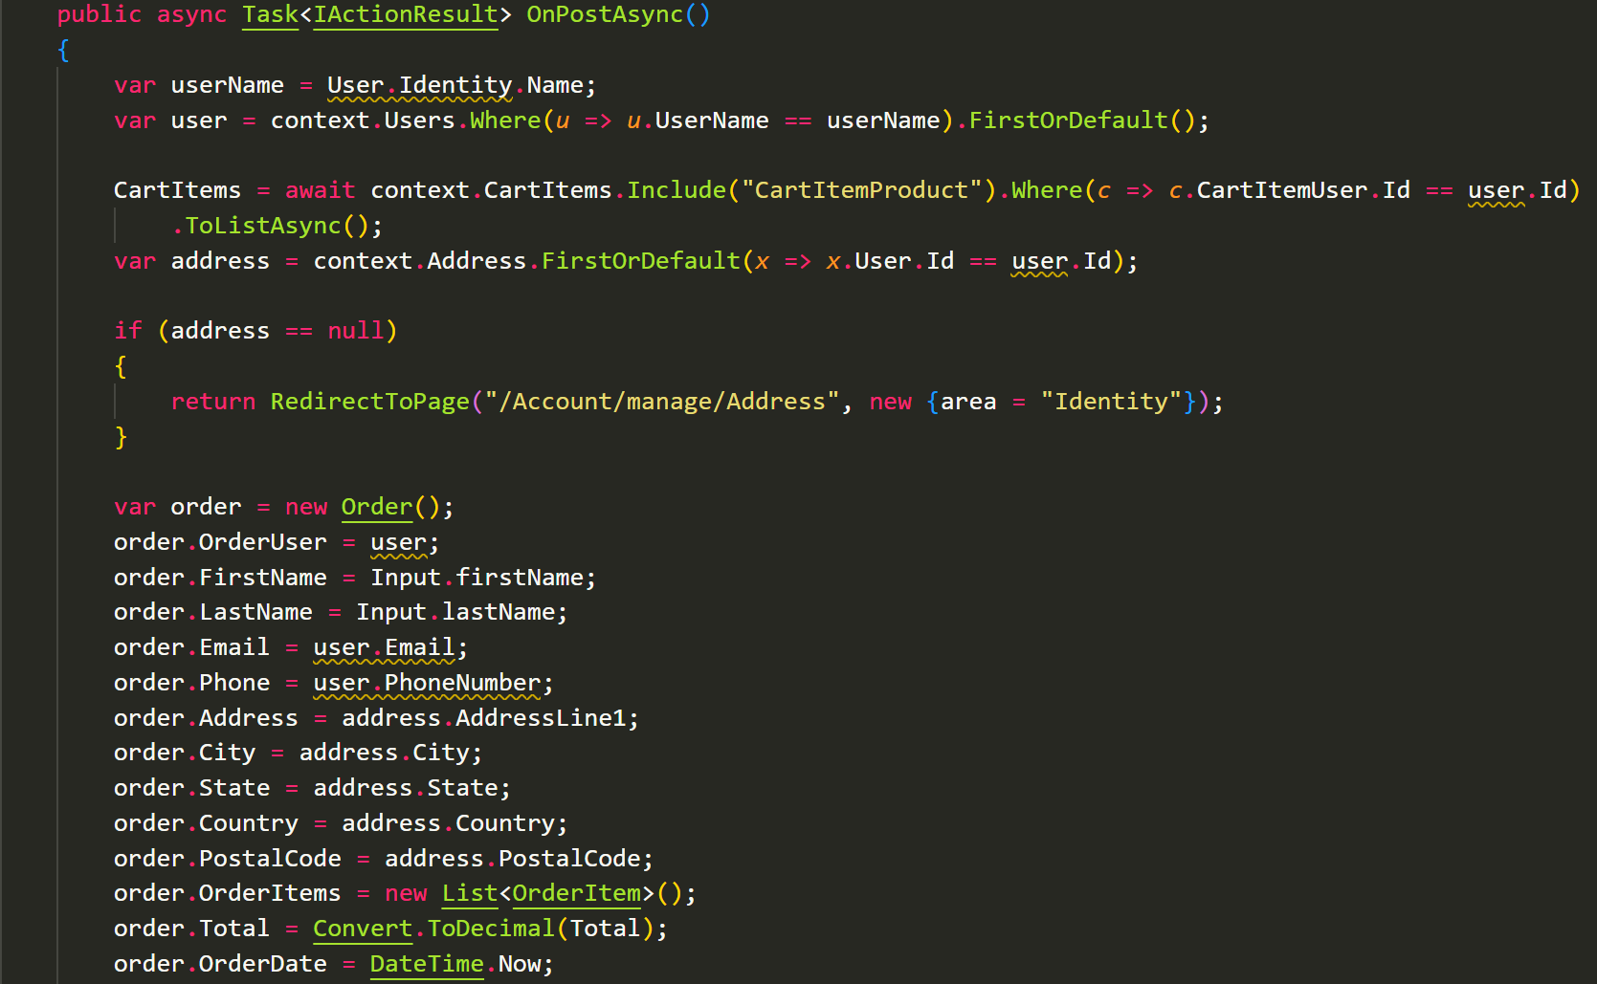
Transaction Page
Challenge: Working with all the variables involved with the user. Case in point, the transaction page was challenging for me because how models interact with each, dictates how you retrieve the information, and how to populate the required field when you must create a new variable.

Slide 5
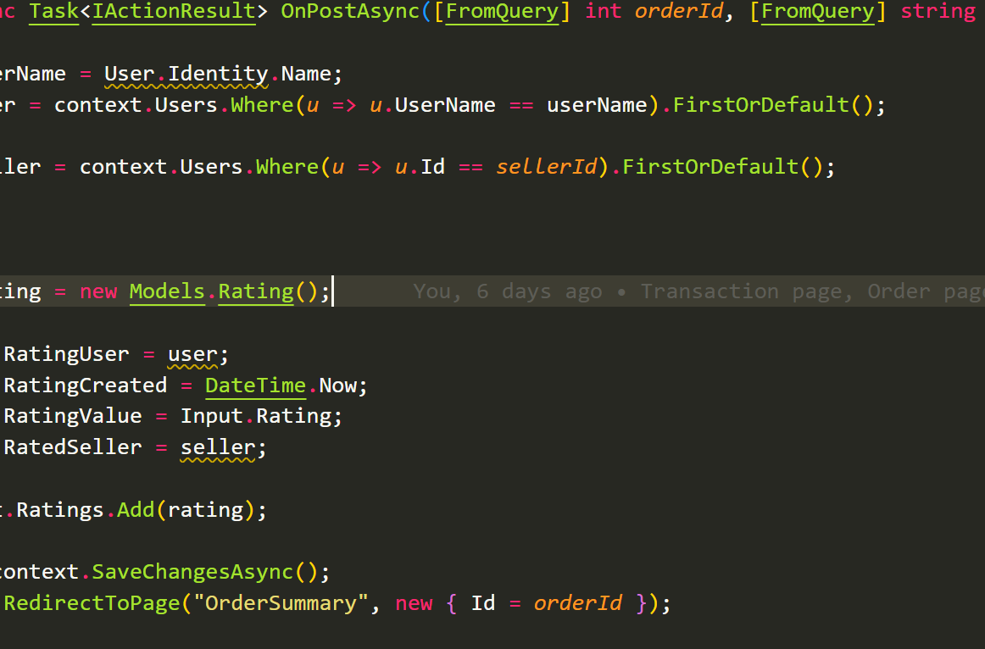
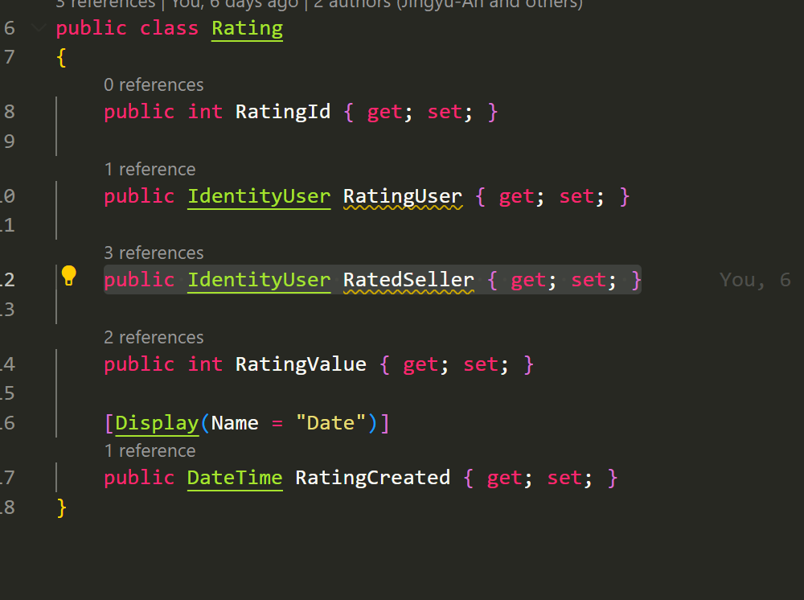
Rating
Further demonstrating the relationships between user and models, I had to create another field in rating to make rating work.
Using [FromQuery] instead of route parameters like we learned in class.
{controller=Rating}/{action=Order/{id}

Slide 6
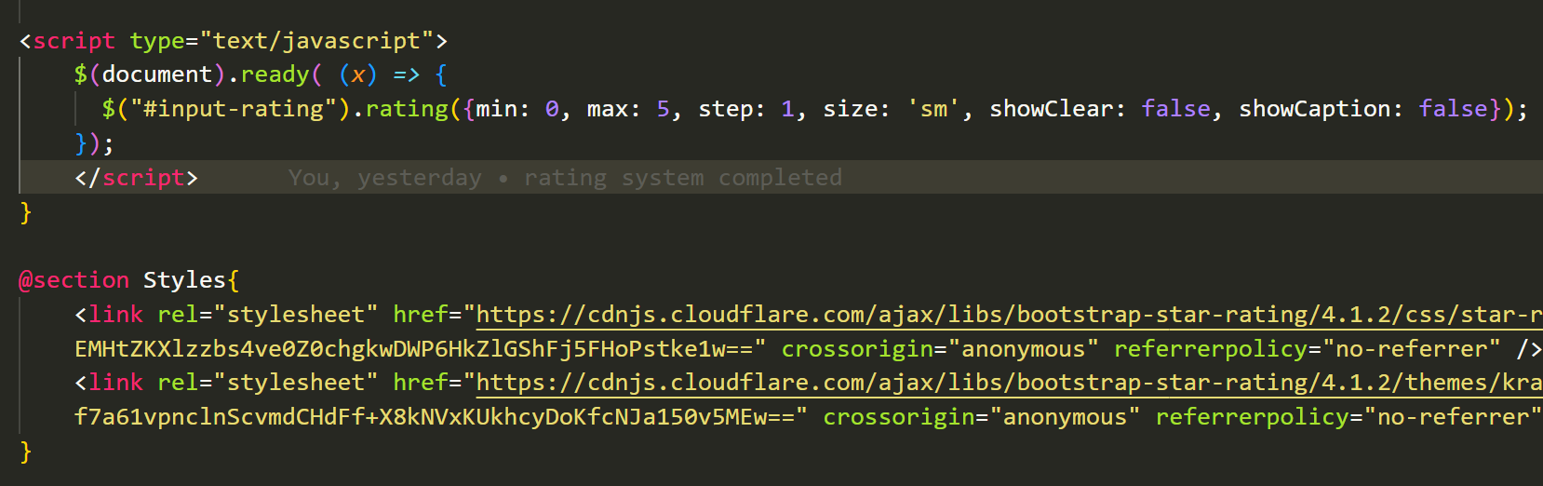
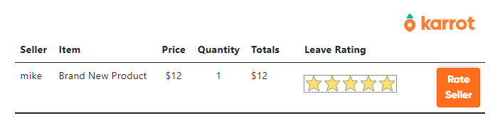
Final Rating
I used bootstrap/krajee and JavaScript.
I first implement rating with an input box, then I added most html and JavaScript to implement the star rating system.

Slide 7
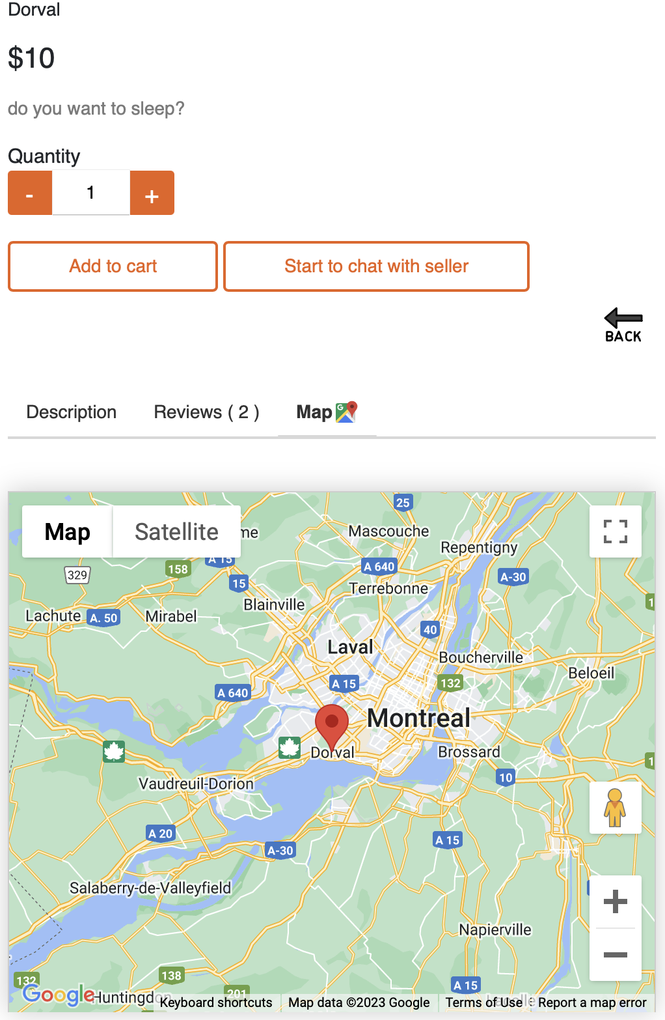
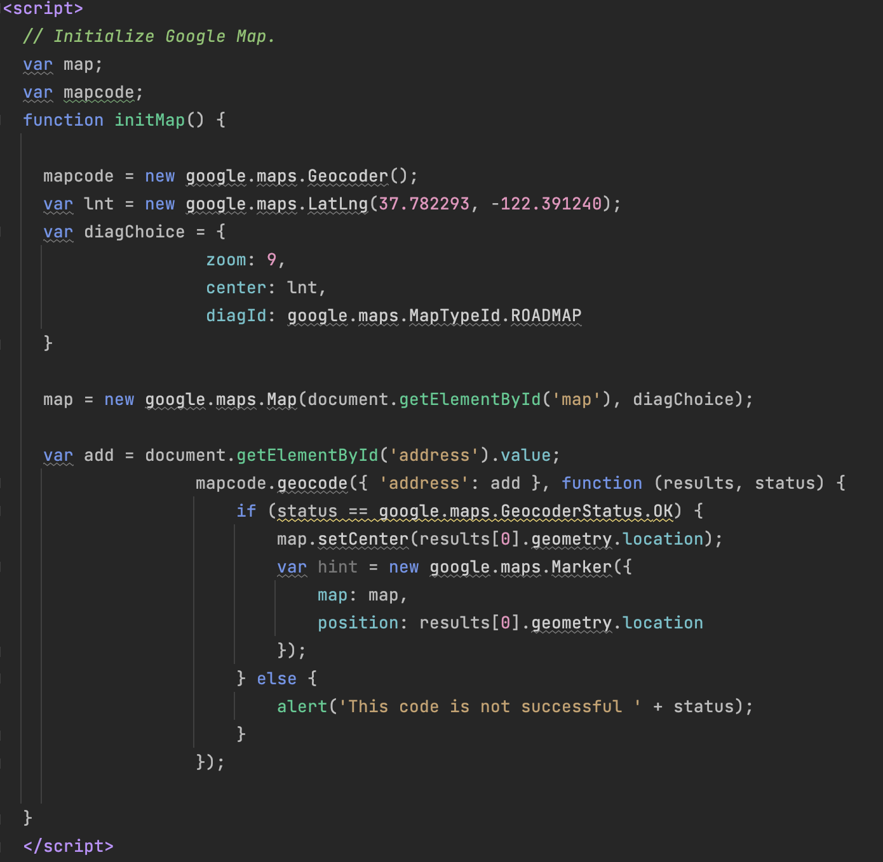
MAP API
Using Google Map API
Based on seller’s city
Notes:
I added some API functions to the project.
The concept of Karrot is a local market place.
The map shows the seller's city.

Slide 8
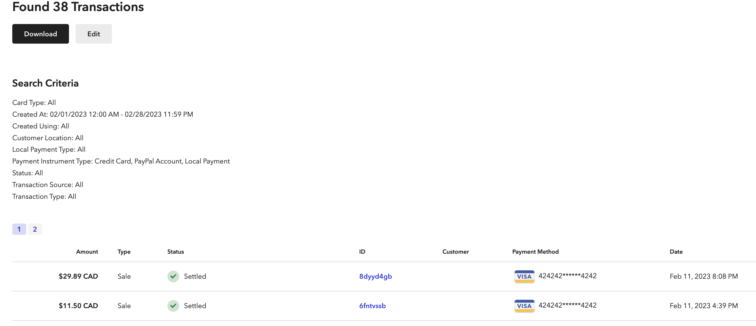
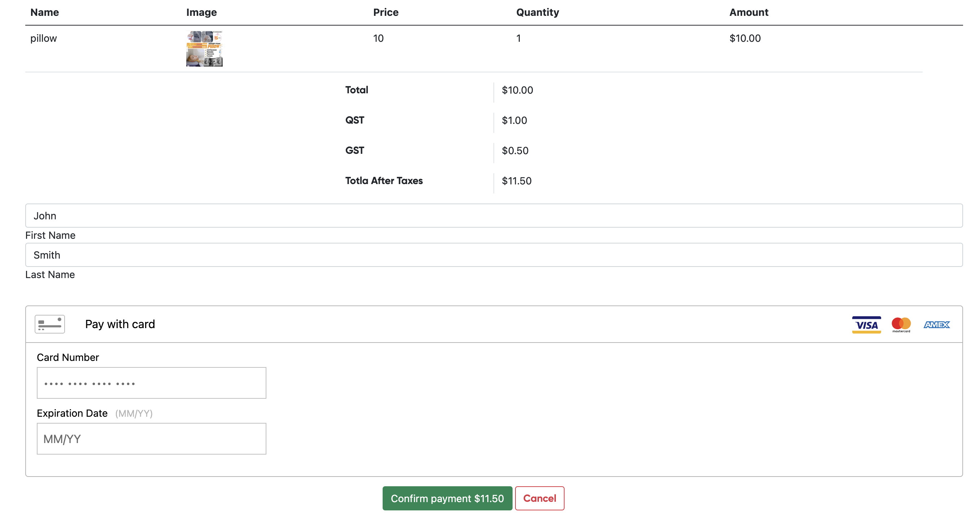
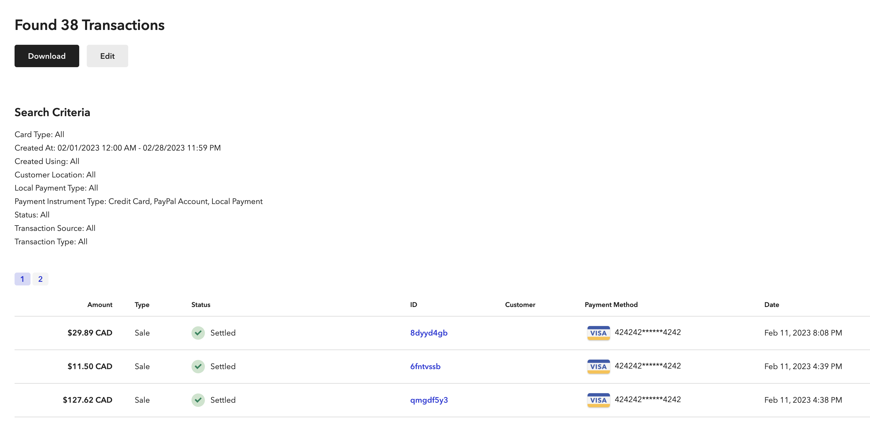
Payment
List of data
Calculate Data
Using Braintree API
Notes:
If you confirm after entering the card number,
Payment is actually made.
Of course, since it is in development mode, there is no charge.

Slide 9
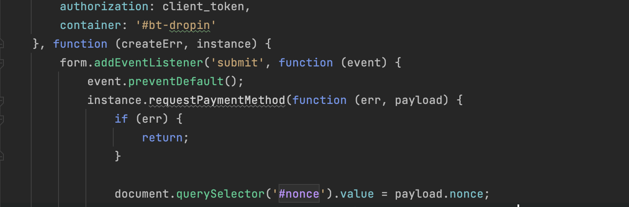
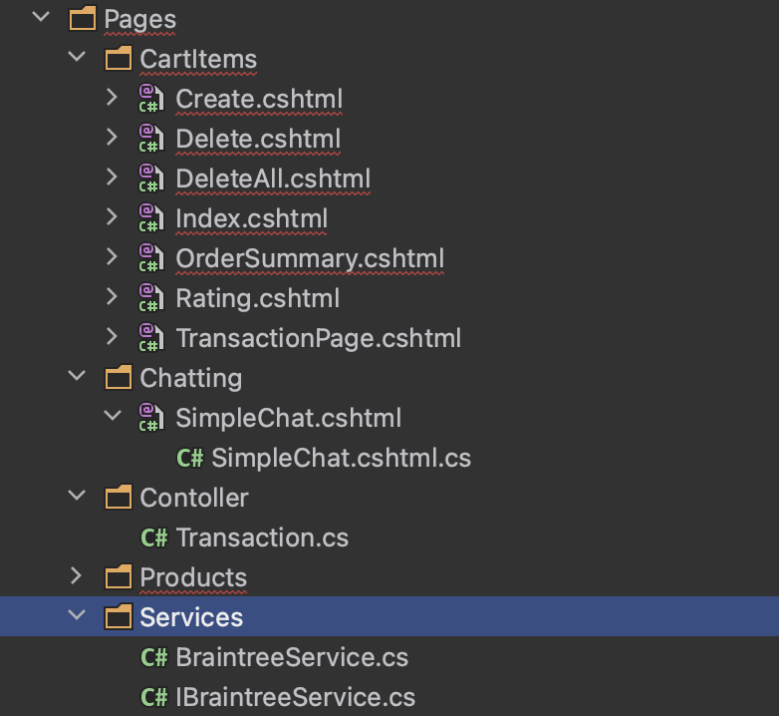
Challenge
MVC patter to Razor page
Notes:
I searched a lot to make razor page into Mvc Pattern.
This was very difficult.
Braintree as well as most of the other Payment APIs were based on mcv or blazor.
At the time, our project was more than halfway through.
It was impossible to change design patterns.
I have no choice,
For the payment API, service and controller are distinguished,
A little more modification to replace the view part with Razor Page
did.
This works, but in the process
I learned that design patterns are very important,
I thought I should be more careful with the initial design.

Slide 10
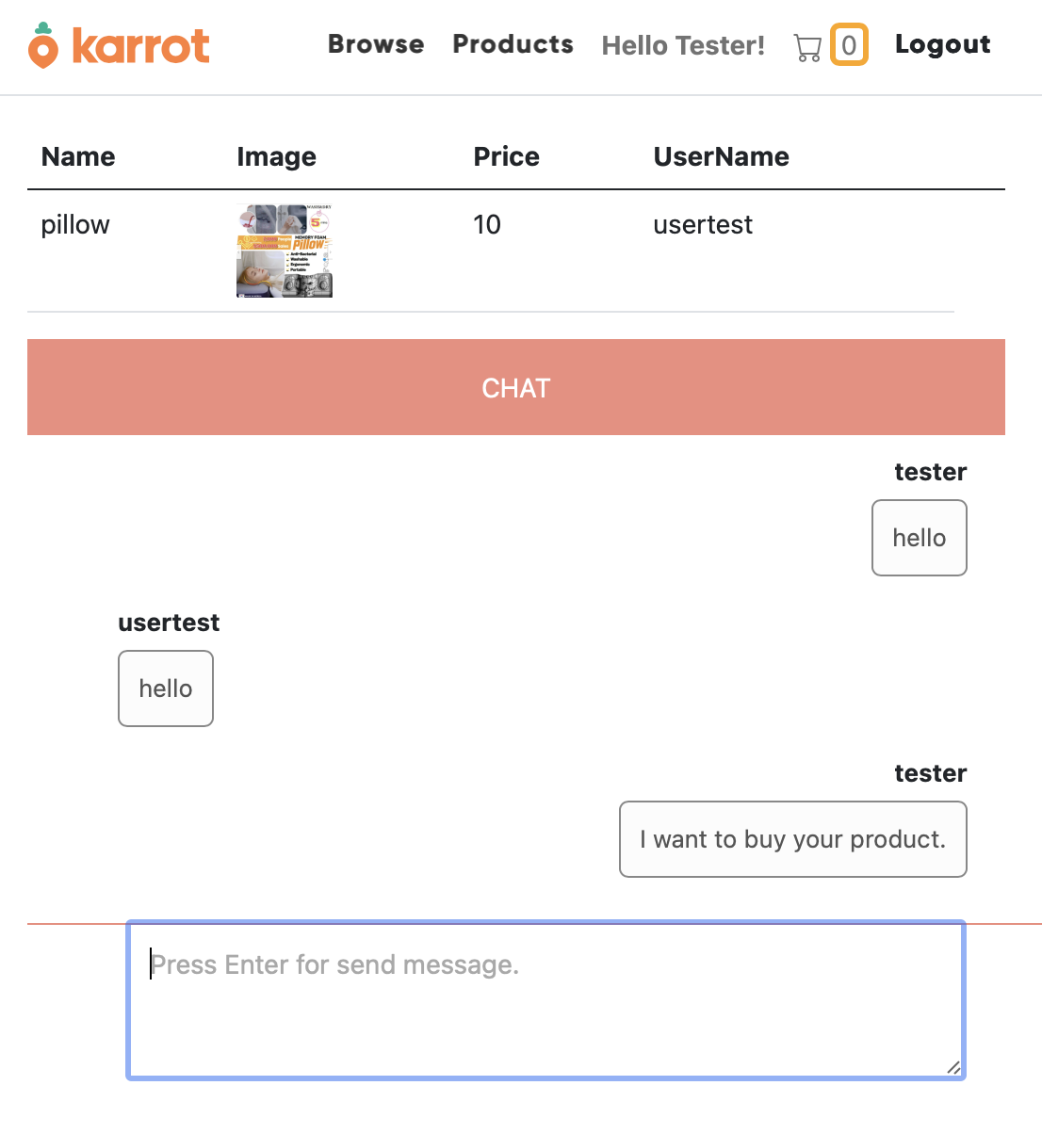
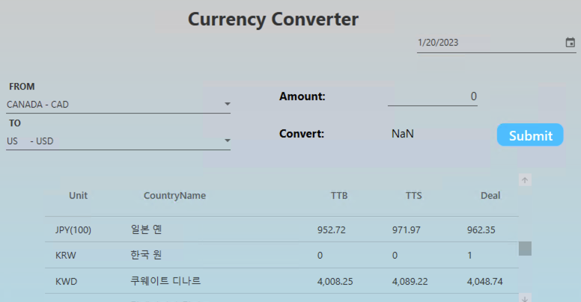

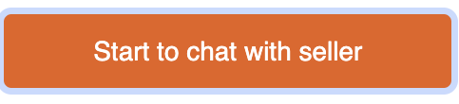
Chatting
Chatting API
Using Signal R API
Making hub
Can group chatting
Right side box : chatting owner
Left side box : seller / buyer
Between users

Slide 11
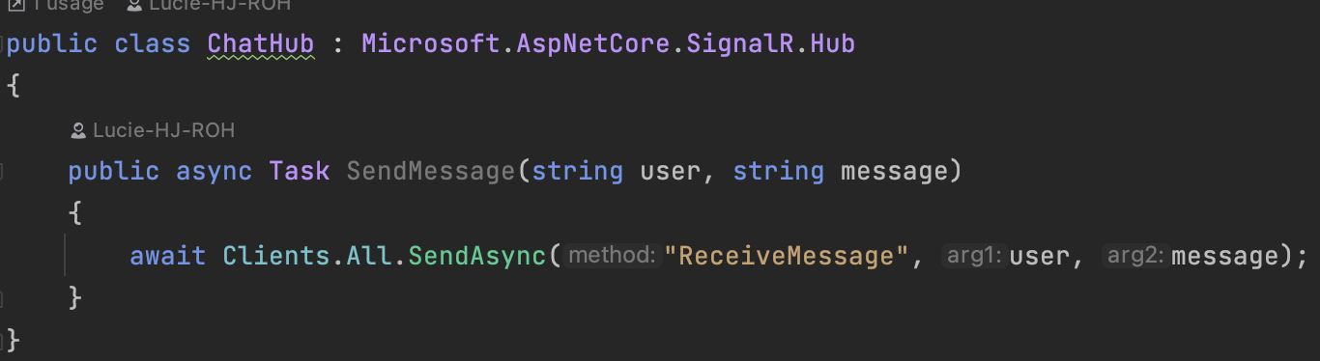
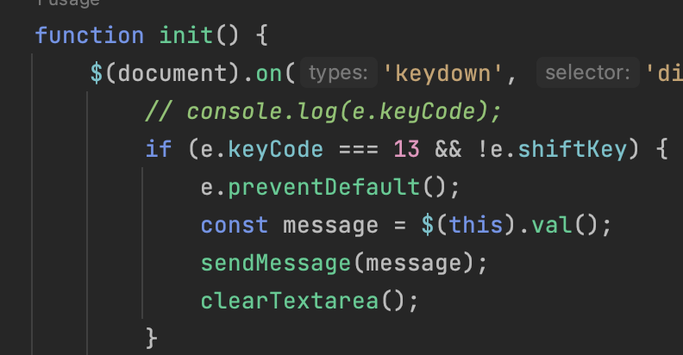
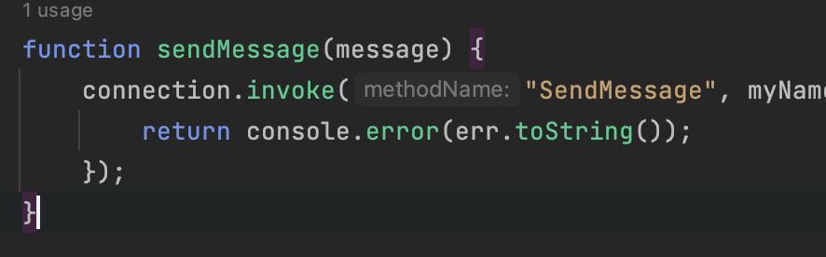
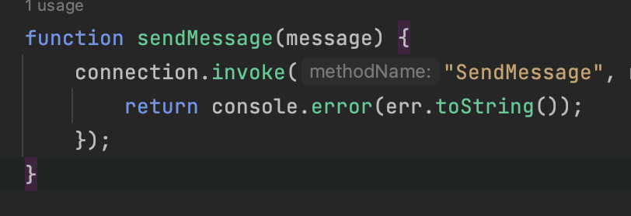
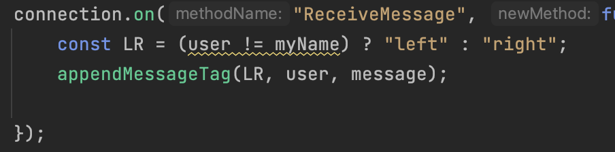
Learned Signal R
Notes:
This was created through SIgnal R provided by C# and based on the tutorial.
Create a chathub to act as a server, and the code for chatting is in JavaScript.
When the user presses the enter key after typing in the chat window,
It is the process by which a message is transmitted.

Slide 12
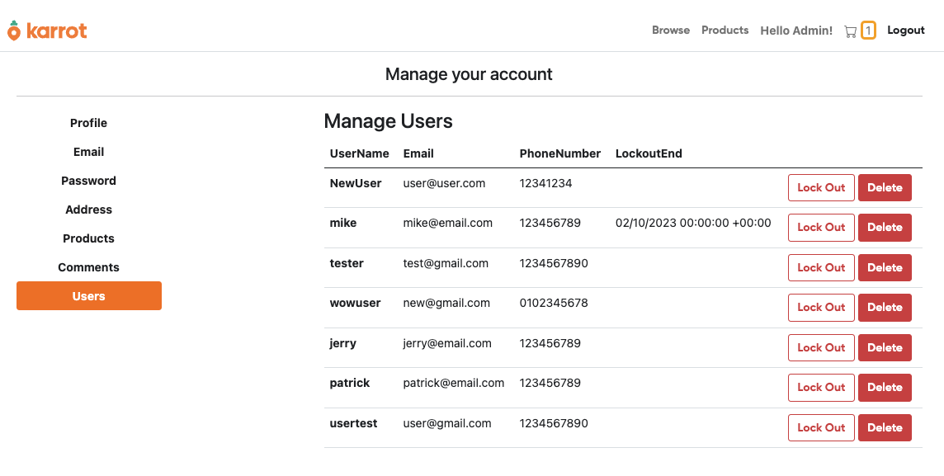
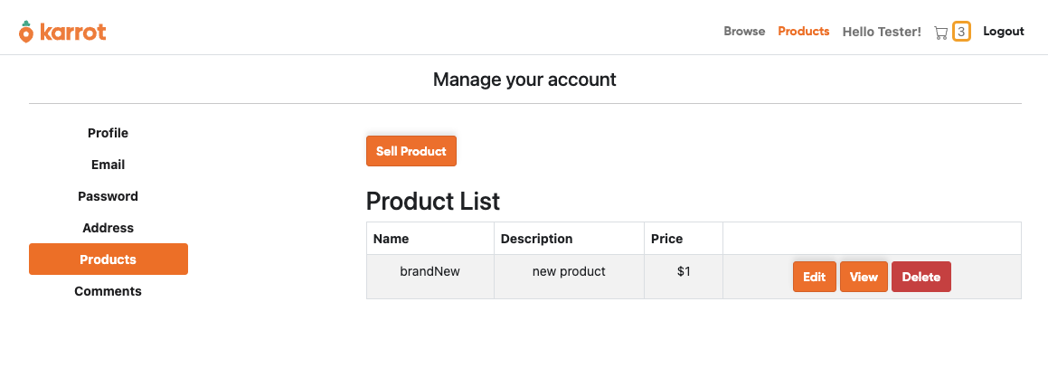
Admin Page
Admin can manage all products, comments, users(CRUD)
Admin can lock out user
User Page
Users can manage only their information, products, comments

Slide 13
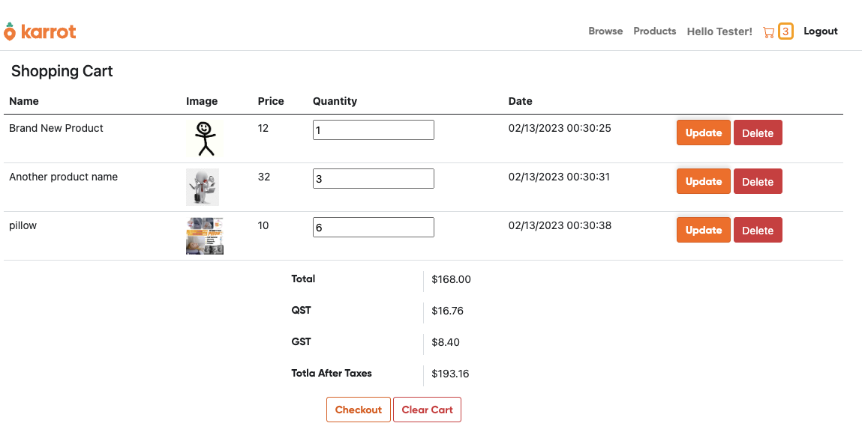
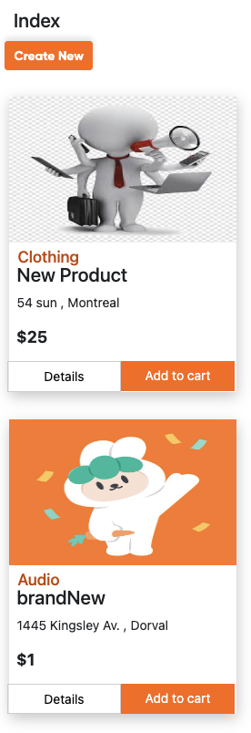
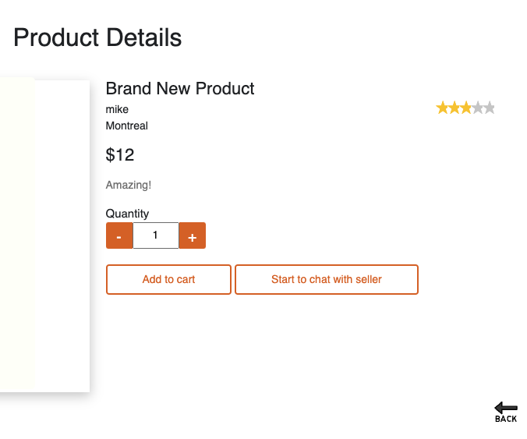
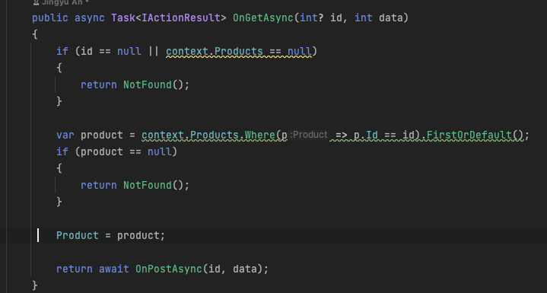
Challenge
Adding Cart Item
On the product page and detail page, it needs add cart item.
It is the same function but works on a different page.
Solution
When the get function is called in the create page of cartitem, it is automatically posted.

Slide 14
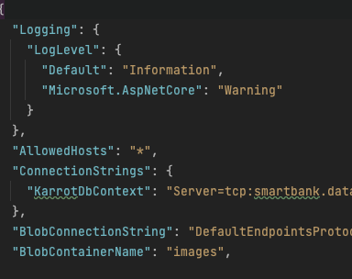
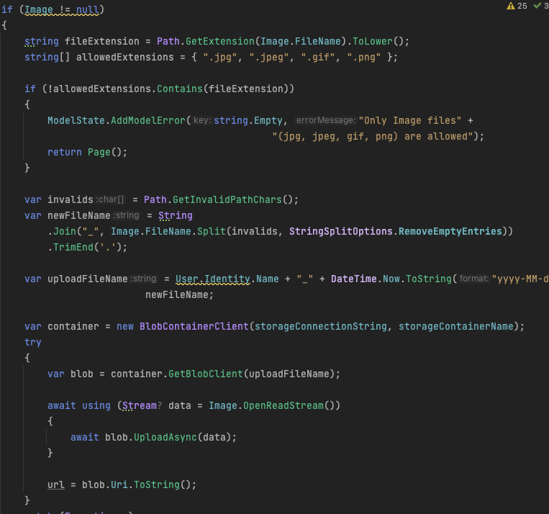
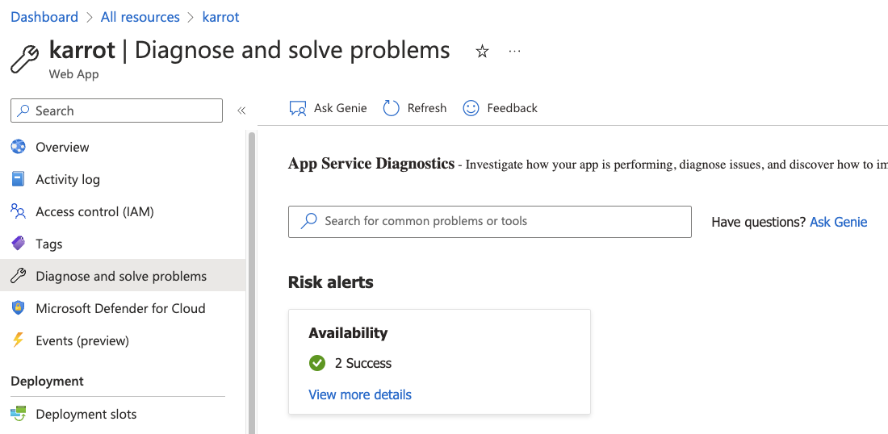
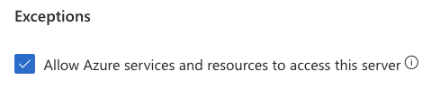
Learned
Blob Storage
Hosting with Azure
Need Connection String and Container Name for using it.
Can upload and delete images.
At first, there were some crashes with the database.
Need to check the server log.
Need check exception about azure services to access.

Slide 15
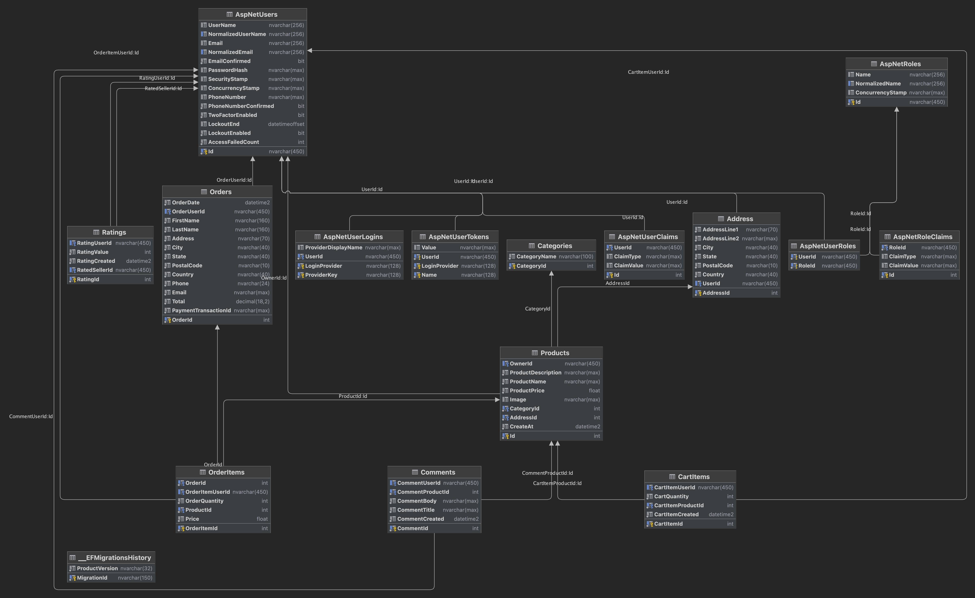
Database Structure

Slide 16

Possible Future Implementations
More Features ?
Integrate a job search page with full crud, chatting, history.
Mobile app
Better UI design
Improved database design

